Slide 1













REFUGEES, THE INVISIBLE VICTIMS!
Sinagra. Sicilia, Italy
22.09-27.09.2016

Slide 2
Dear partners and participants,
Our meeting in Italy for the project “REFUGEES. THE INVINSIBLE VICTIMS!“ will be from 22nd to 27th of September 2016.
I would like to give you some practical information. I hope all’s clear but if you need clarification don’t hesitate to contact us.
You're free to arrive earlier or leave later but additional costs of accommodation, food, etc. have to be paid by yourself. In this case you can buy the arrival airplane tickets maximum 1 day before the starting date of activities and your departure airplane tickets maximum 1 day after the date of the end of activities and, if request, we can assist you in finding accommodation and arranging local transport.
Participants need to bring back and submit us the original tickets , invoices, boarding passes in order to get their reimbursement from us. All the requested documents serve as supporting documentation for the project final reporting.
Invoices should be in Euro and the name of participants should be written on the invoices. If participants do not submit the respective original documents to us their payment will not be reimbursable.

Slide 3
TRAVEL COSTS
The grant support to travel costs is calculated according the distance band from your town to Brolo town (where the project activities will be held) using the distance calculator provided by European Commission as indicated below:
EGYPT (TRAINING WITHOUT BORDERS) | 170.00 €
JORDAN (UNITED RELIGIONS INITIATIVE MIDDLE EAST & NORTH AFRICA | 270,00 €
TURKEY (UNIVERSIDAD BAYAZIT YILDIRIM) | 170,00 €
CROATIA (MLADI ZA MAROF) | 170,00 €
ITALY (AYUNTAMIENTO DE BROLO) | 20,00 €
PORTUGAL (BUE FIXE) | 170,00 €
MACEDONIA (CENTER FOR RURAL DEVELOPMENT) | 170,00 €

Slide 4
Your required contributions are:
a participation fee of € 40,00 for each participant
travel costs up to the maximum amounts granted by the Program.
---
We strongly recommend you to arrange a travel and health insurance which covers the period you will be in Italy. We do not reimburse insurance costs.

Slide 5
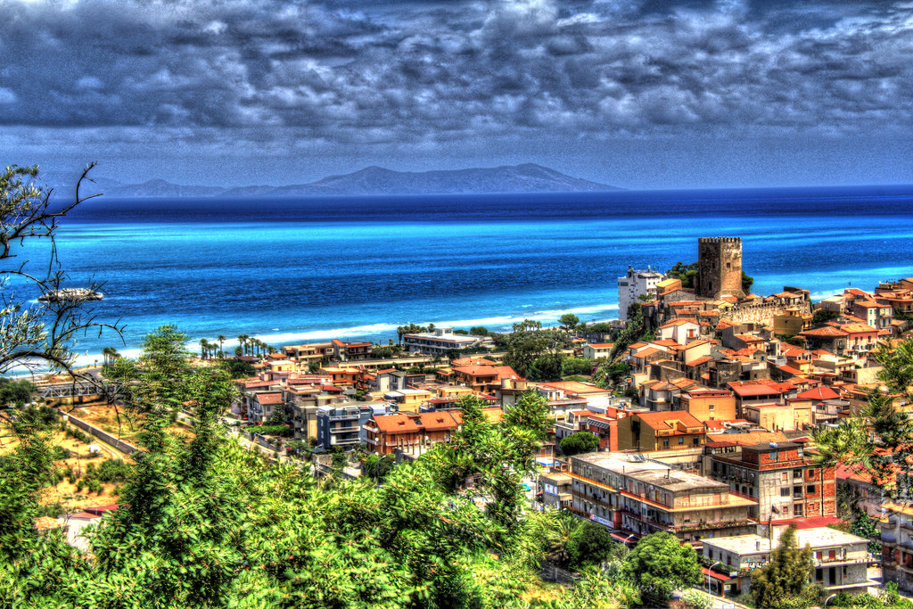
VENUE OF ACTIVITIES
Activities of this youth exchange will be implemented in Brolo, the town in which is located the Hotel Gattopardo.

Slide 6
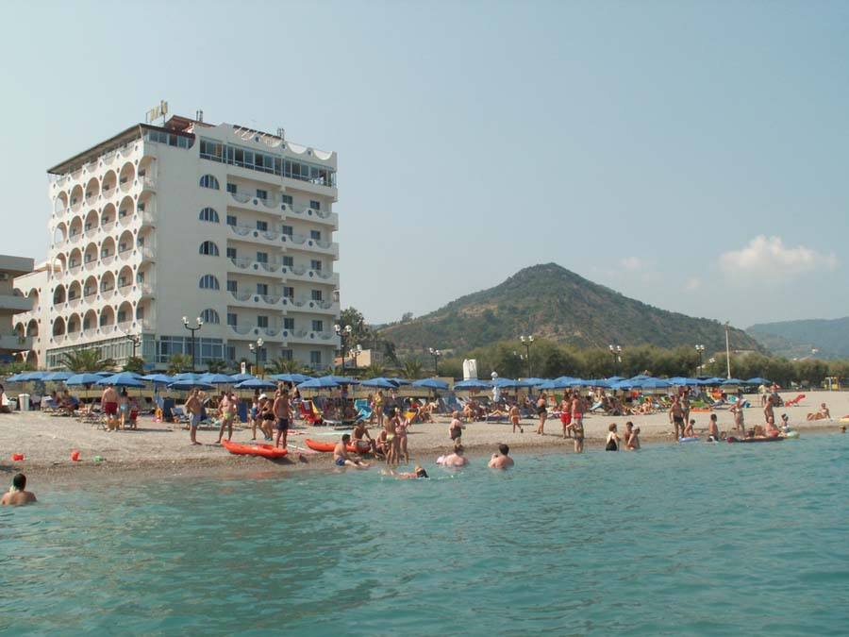
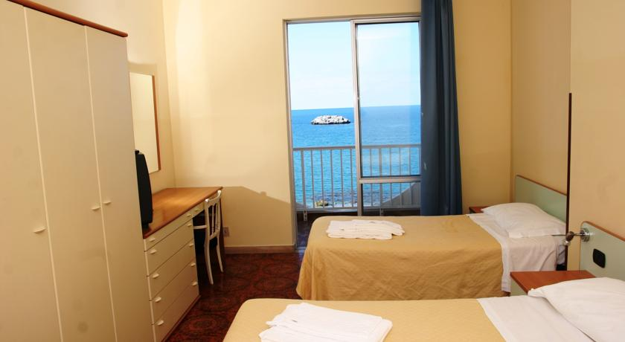
ACCOMODATION
We will be lodged at the traditional "Hotel Gattopardo“ (Via Marina 69, 98061 Brolo , tel.: +39.(0)941.561412 –www.gattopardobrolo.it).In the Hotel there's free wireless internet connection.

Slide 7
TRANSFER FROM AIRPORT TO THE VENUE:
Please keep in mind that from the airport of Catania or Palermo you will still need to take a return trip by bus or train to the venue of the activities which will cost you around 35EUR (round trip). Only the cheapest way of travel is eligible.
Taxi costs and trips in private cars cannot be reimbursed.

Slide 8

FOR PARTICIPANTS ARRIVING AT PALERMO'S AIRPORT:
From the Airport of Palermo you can travel to Palermo Central Railway Station and then from Palermo Central Railway Station you can get BROLO the town in which activities will be held.
TRANSFER FROM PALERMO'S AIRPORT TO PALERMO CENTRAL RAILWAY STATION. you have two options : by bus or by train
1st option: by bus
There’s a bus transport service to get Palermo Central Station from Palermo’s airport. The name of the Company is “PRESTIA & COMANDE’”. Askfor one way ticket to PalermoCentral Station
Here are timetable of bus service from Palermo airport to Palermo Central Station:
http://www.prestiaecomande.it/?idPlugin=20749&amp;amp;idx=317

Slide 9
FOR PARTICIPANTS ARRIVING AT PALERMO'S AIRPORT:
2nd option : by train
In Palermo’s airport ask for one way ticket to one of the following station of arrival from the following three, listed in order of preference1st: BROLO -FICARRA2nd: CAPO D'ORLANDO -NASO3rd: S.AGATA DI MILITELLO
BUT DON’T FORGET YOU HAVE TO CHANGE TRAIN IN PALERMO CENTRAL STATION
below are the links of the Italian railways.
http://www.trenitalia.com/cms/v/index.jsp?vgnextoid=4ddd1a035296f310VgnVCM1000005817f90aRCRD

Slide 10
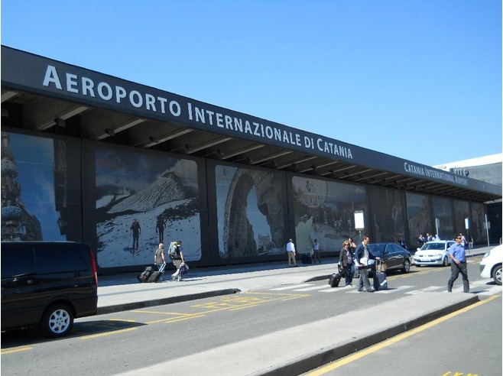
FOR PARTICIPANTS ARRIVING AT CATANIA 'S AIRPORT:
From the Airport of Catania you can travel to MESSINA City and then from MESSINA City you can get BROLO the town in which activities will be held.
TRANSFER FROM CATANIA'S AIRPORT TO MESSINA CITY
There’s a good bus transport service to get Messina from Catania’s airport. The name of the Company is “SAIS AUTOLINEE” . The desk for tickets and the starting place of bus are close the exit of airport. Ask for one way ticket to Messina Central Station
Here are timetable of bus service from Catania airport to Messina:
http://www.saisautolinee.it/ricerca/orari.asp

Slide 11
TRANSFER FROM MESSINACITY TO BROLO
For transfer from Messina City to Brolo you have two choices: by bus or by train
1) TRANSFER BY BUS:
The bus station is close to Messina Centrale railway station (the place of stop of the bus you took in Catania’s airport) .
No more than five minutes walk : ask to the bus driver for “MAGISTRO BUS” or “TAI BUS”or see the picture (Bus terminal Via Santa Maria Alemanna):
here are timetable of bus service from Messina to Brolo:
http://www.autolineemagistro.it/

Slide 12
2)TRANSFER BY TRAIN:
You can choose your railway station of arrival from the following three, listed in order of preference 1st: BROLO –FICARRA 2nd: CAPO D'ORLANDO –NASO 3rd: S.AGATA DI MILITELLO
below are the links of the Italian railways.
http://www.trenitalia.com/cms/v/index.jsp?vgnextoid=4ddd1a035296f310VgnVCM1000005817f90aRCRD

Slide 13
EMERGENCY CONTACTS:
CAMILA VAZQUEZ CONDE:
+34 655 179 805
+34 911 704 618
adefis.juventud.internacional@gmail.com
ANGELA FOGLIANI:
+39.(0)941.594056
+39.338.3778939
angelafogliani@gmail.com

Slide 14
BOARDING PASSES
It is extremely important that you keep all the boarding passes from the different flights as well as train and/or bus tickets. So PLEASE, KEEP THEM SAFELY.
The ones from your way to Italy will be asked during the project, the ones from your way home should be sent as soon as possible by post mail to the following address:
Petronio 20.
28231 Las Rozas de Madrid, Madrid
Espana

Slide 15
PHONE AND MAIL CONTACTS
CAMILA VAZQUEZ CONDE
+34 655 179 805
+34 911 704 618
adefis.juventud.internacional@gmail.com
Do not doubt to contact us if any plane is delayed. We will appreciate it.
As always, do not hesitate to contact me for any question or concern.

Slide 16
Important!
Please , when you buy tickets make an invoice with the data of Adefis Juventud Internacional
VAT NUMBER: G 866 246 99

Slide 17
SEE YOU!

